Slide 1
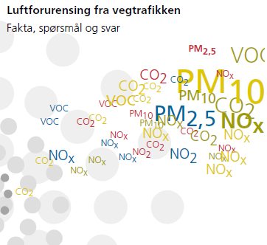
Measures to control air quality in Oslo, Norway.
Norwegian Public Roads Administration
Nina Martinsen
Karl Idar Gjerstad

Slide 2
Contents
Current situation in Oslo
Measures for road dust, PM₁₀
Measures for NO₂
The success of electric cars
Information and communication

Slide 3
PM₁₀-concentration in Oslo
Notes:
From 2004 until today, the concentration of PM10 in Oslo has decreased. This is mainly because of the effective abatements against road dust in Oslo. We will come back to this later in the presentation.

Slide 4
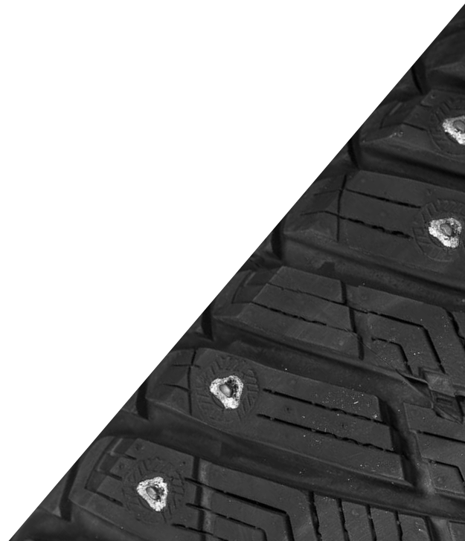
Mitigations of road dust, PM10
Less studded tyres
Tax
Information campaign
subsidies for the purchase of studless tyres
Reduced speed limits
Road maintenance

Slide 5
Tax for studded tyres
In Norway the local city may introduce tax for studded tyres
Tax for studded tyres in Oslo and Bergen
Previously also in Trondheim
Tax fee for a season is 1200 NOK ≈ 150 €
Studded tyres also reduced accidents, therefore:
No tax in smaller towns
Studded tyres will never be banned in Norway
Fine for using studded tyres without paying the tax.

Slide 6
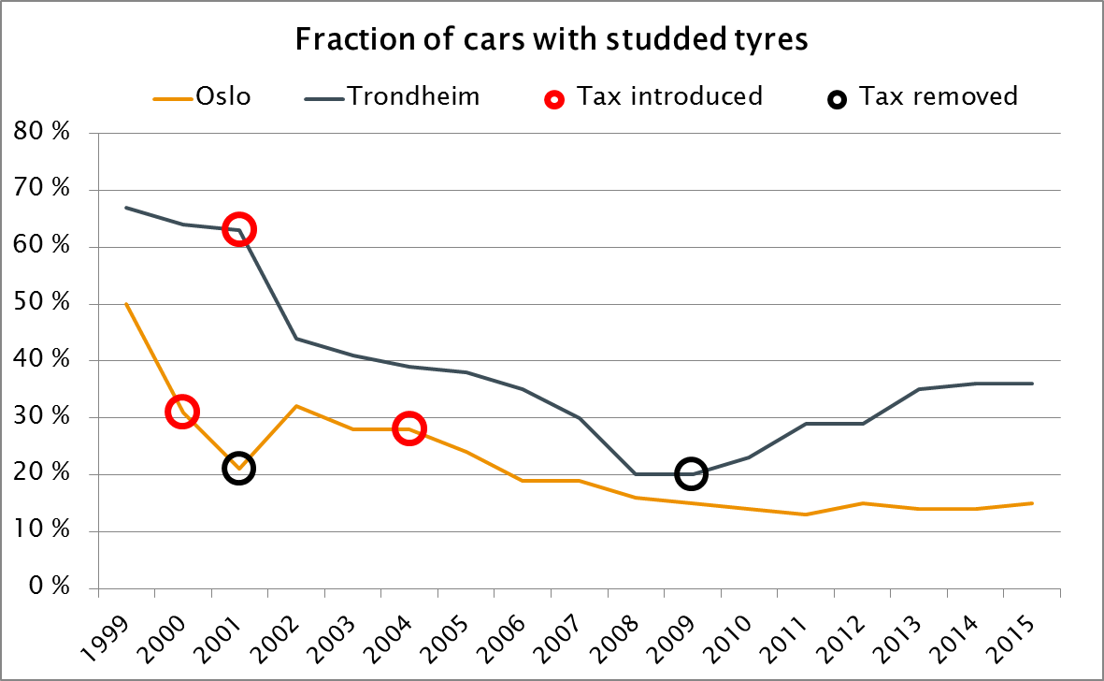
Tax for studded tyres is effective

Slide 7
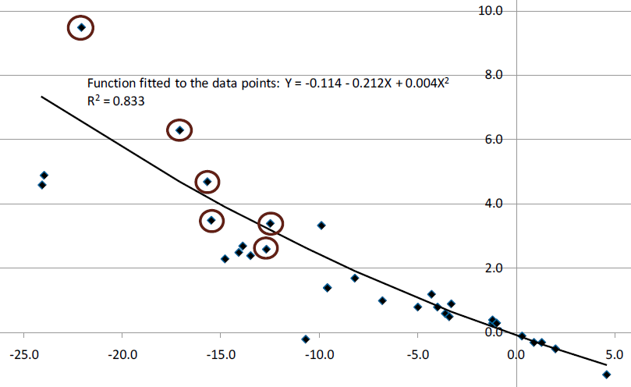
Studded tyres and car accidents
Percent change in the number of injury accidents
Change in percent points in studded tyres
There was no change in the number of insurance reported accidents

Slide 8
Information campaign in Stavanger
NOTE: Wordplay!
Norwegian: «Pigg» = «Studded»
«Piggfri» = «studdless»
«Pig Free» supposed to be funny
Cooperation between
Local city
NPRA
Tyre outlets
Car federation
Objective: 10 % studded tyres 28 % → 22 % first year

Slide 9
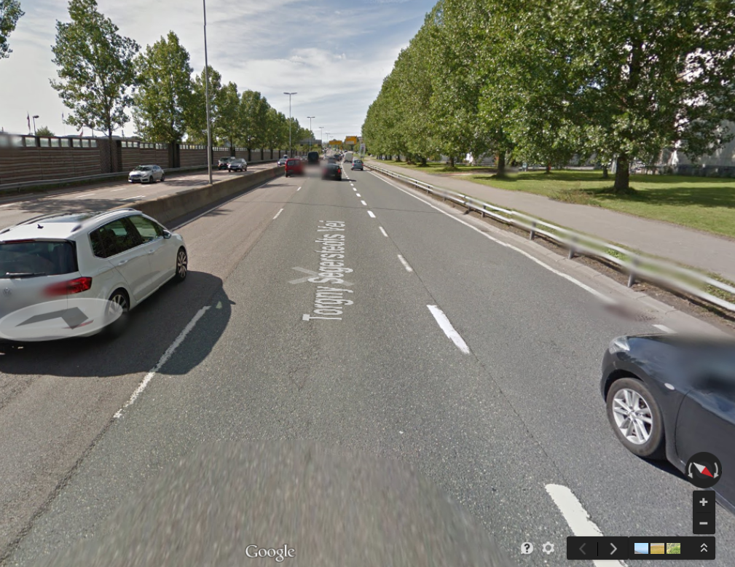
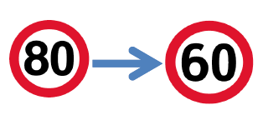
Reduced speed limit during winter season
Speed limit: 80 km/h → 60 km/h
Real speed reduction: ~ 10 km/h
Reduction of PM10 concentration: 30 – 35 %
Also positive side effects:
Less noise
Less accidents; ~ 40 %

Slide 10
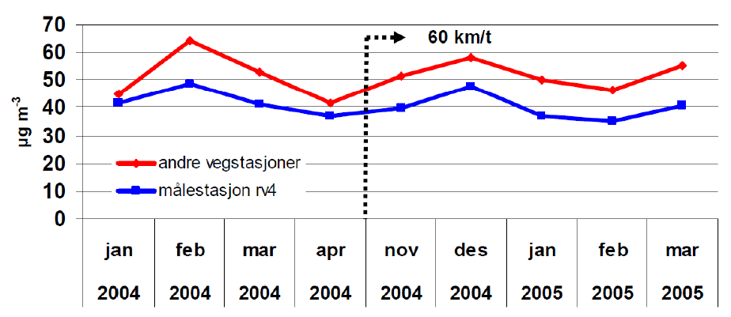
Study of reduced speed in 2005
Measurements of NO2, blue line is test site

Slide 11
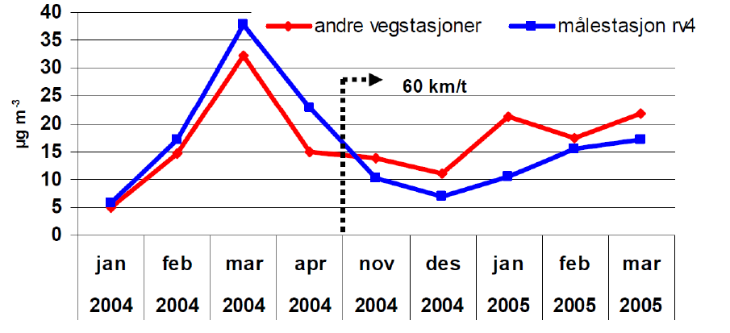
Study of reduced speed in 2005
Measurements of PM10, blue line is test site

Slide 12
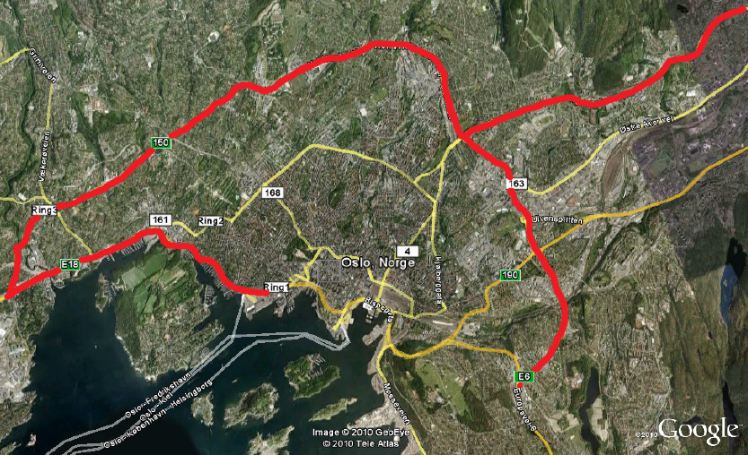
Reduced speed 2005 - 2013
No extra speed control
Very few speeding tickets

Slide 13
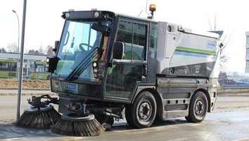
Road maintenance
Sprinkling of road with MgCl₂
PM₁₀ reduced by 15 %
Road cleaning
Unknown effect
We need more research

Slide 14
NO₂-concentration in Oslo
Notes:
The main challenge in relation to current regulatory requirements is related to the levels of NO2 concentration. There is a growing concern about the high numbers of people currently exposed to exceedances of the annual mean of NO2 in Norwegian cities. This is Oslo.

Slide 15
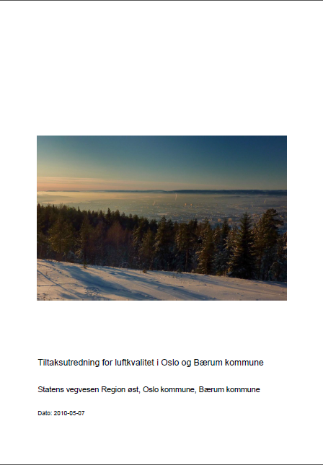
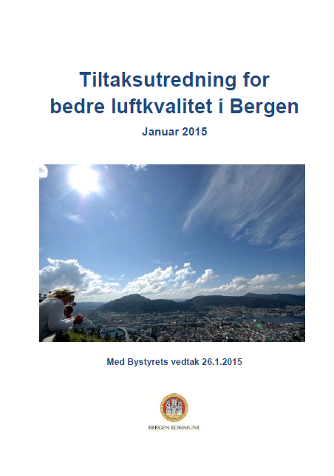
Measures for NO₂
Notes:
Because of the increasing exceedances of the limit values, especially of NO2, it has been developed many action plans in the biggest cities in Norway during the last years. These reports includes advices on what measures should be considered in order to secure that the air quality limits will be met in the future.

Slide 16
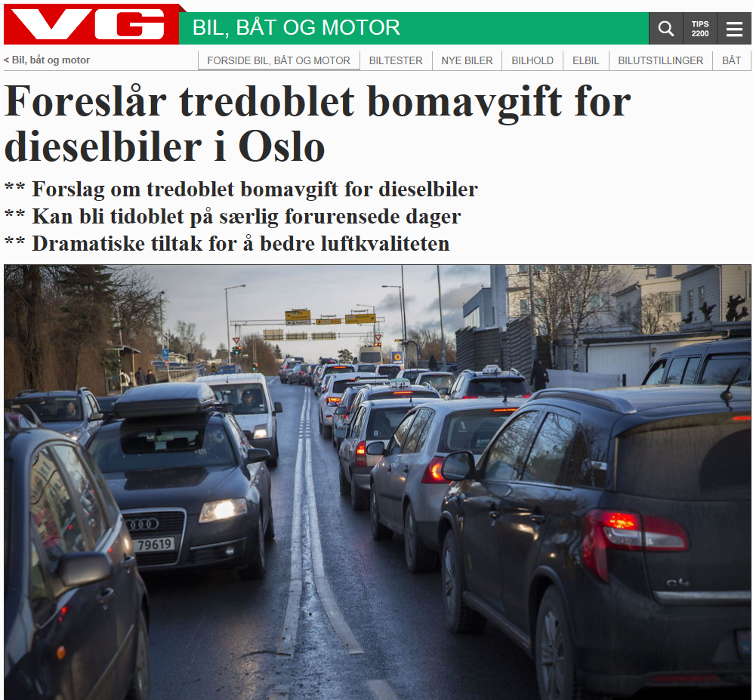
Measures for NO₂
Odd- and even numbered license plate
Results from Bergen 2010: 30 % reduction in traffic volume.
Only private cars, not heavy vehicles.
Many has access to multiple cars; use the car with the “right number”.
Temporary increased toll plaza
Temporary prohibition of diesel cars
→ Political aspects.
Notes:
In situations with especially high NO2 levels it may be necessary to implement measures against the most polluting cars to reduce the volume of traffic quickly.
Driving restrictions for cars with high emissions (diesel cars, heavy vehicles) have been discussed, and some places tried out.
In 2010 , odd-even driving policy were introduced in Bergen, at the westcoast in Norway. By allowing cars that had an even last number of their license plates to be able to drive on roads in one day while the cars that had an odd last number of their license plates could drive on the road the next day in order to improve air quality in the city. This measure gave a reduction in traffic volume by 30%. Although there were 50% of the cars that were affected, the traffic volume didn’t went down by 50%. This was mainly because many people had access to another car with the "right" number, and the measure only included private cars and not heavy vehicles and commercial traffic.
The introduction of low emission zones (zones with specific requirements for emissions from heavy and light vehicles within a limited urban area) may be an appropriate measure, but the regulations and how this should be followed up is unclear. It also include political aspects.

Slide 17
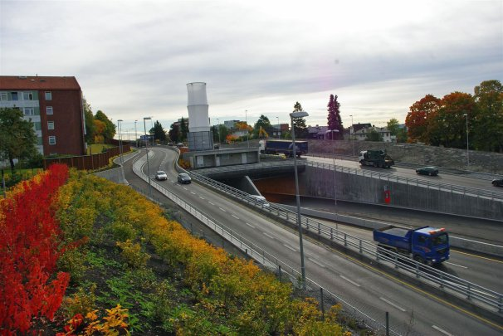
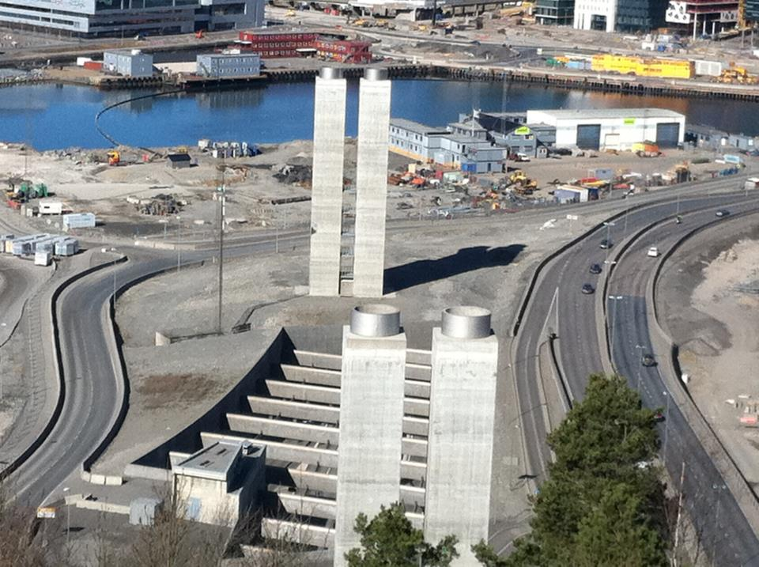
Air pollution from tunnels
Air pollution around tunnel portals- an increasing challenge.
Ventilation towers
Notes:
Oslo is the city in Europe with the most tunnels. We are seeing an increasing challenge of managing air pollution surrounding tunnel portals.

Slide 18
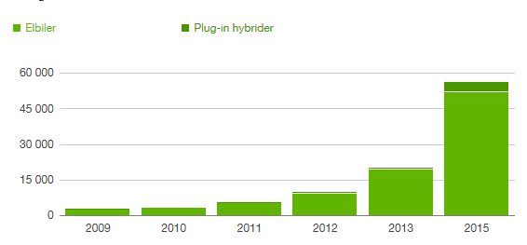
The success of electric cars
Notes:
Norway has a high proportion of electric vehicles. Norway has many more electric vehicles than Sweden because we have a tax policy that have motivated people to buy electric cars. The reason for the great success of electric cars in Norway has been the economic benefits:
- The annual motor vehicle tax is very low
Free parking in municipal parking places.
Free passage in all the tolls
Free access to drive in the collective field.
This high proportion will reduce emissions of NO2 and CO2 in Oslo.

Slide 19
The communication of measures
Tax for studded tyres
Tax for studded tyres
Tax for studded tyres
Reduced speed limit
Reduced speed limit
Reduced speed limit
Temporary increased toll plaza
Temporary increased toll plaza
Temporary increased toll plaza
Temporary prohibition of diesel cars
Temporary prohibition of diesel cars
Temporary prohibition of diesel cars
Odd- and even numbered license plate
Odd- and even numbered license plate
None
Notes:
Annual surveys of behavioral and attitude changes over time have been collected to identify how measures will affect people in Oslo. As we can see, people in Oslo are most found of measures which reduce PM10-concentration, while measures that affect their ability to travel or increased taxes are harder to communicate. These measures are also more political.

Slide 20
Thank you for your attention!
nina.martinsen@vegvesen.no
karl.gjerstad@vegvesen.no

